Slide 1

INSTRUCTION GUIDE
Dear Mo Legend,
April is Testicular Cancer Awareness Month (TCAM).
It’s an important Mo-ment to raise awareness around the #1 most commonly diagnosed cancer in young men and to make sure guys know the importance of checking their nuts regularly, along with how to do it!
We couldn’t change the face of men’s health without you.
Thanks for leading the hairy charge!
HOW CAN YOU HELP?
We've put together these slides (and speaking notes) to help you spread the word.
​
Ask your boss to speak for
5 minutes before your next team meeting or company get together.
Inside you’ll find:
Testicular Cancer facts & stats
Impactful videos
Guide on how to perform a self-check​
Suggested speaking notes for each slide in the notes section
FOR PRESENTORS
(DELETE AFTER READING)

Slide 2

TESTICULAR CANCER
AWARENESS MONTH
EVERYTHING YOU NEED TO KNOW ABOUT TESTICULAR CANCER
Notes:
Well folks, it’s that time of year… the days are getting longer… flowers are blooming… hockey playoffs are upon us…. And yes, April is Testicular Cancer Awareness month.
Get Excited!!
In all seriousness, this past November we rallied as a team/company to raise some serious funds and conversations for an amazing cause: Movember & men’s health.
The folks at Movember shared this quick PowerPoint to help us continue the conversation – afterall our health matters all year round (not just for one month) and we could probably use a reminder on a few things.

Slide 3
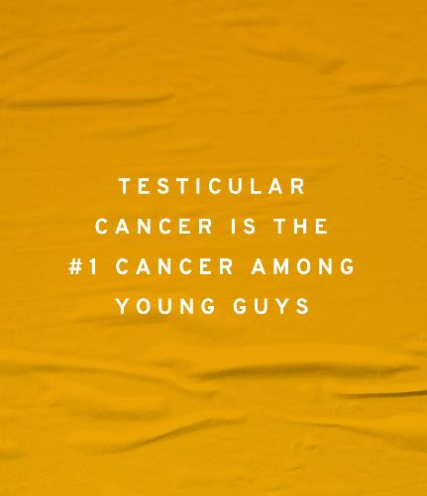

What is it?
April is testicular cancer awareness month.
Know Thy Nuts is an annual campaign encouraging guys everywhere to get to know their nuts.
Notes:
This month Movember has launched their “Know They Nuts” campaign in support of Testicular Cancer Awareness Month
This is an important Mo-ment for everyone. As Testicular Cancer is the #1 most commonly diagnosed cancer for men aged (18-34)
Their campaign is called “Know Thy Nuts” and it’s all about encouraging guys everywhere to… well… get to know their bodies and take action if something feels off.
We know men aren’t always the best at going to the doctors (or thinking about their health in general) so this is an important reminder. Especially since testicular cancer is the #1 most diagnosed cancer in young guys.
Lets take a look at the numbers… (next slide)

Slide 4
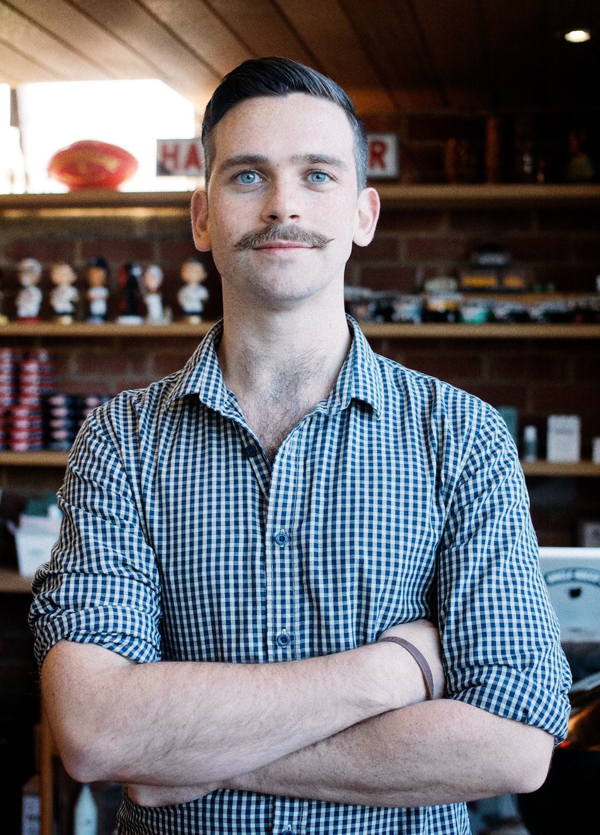

#1
62%
Testicular Cancer is the #1 diagnosed cancer in young men aged 15-40 years old
of men don’t know how check their nuts.
95%
70,000
When caught early, testicular cancer has a greater than 95% survival rate however lot of guys still experience negative side effects from treatment
While it’s rare (it accounts for 1%
of all male tumours), there are still
70,000 men across the world who are diagnosed with the disease each year
Testicular cancer by
the numbers
THE SOLUTION
The best thing you can do is get to know your nuts, know what's normal for you, and if there are any unusual changes or something just doesn't feel right for you, see a doctor.
Notes:
As mentioned, this is the #1 most commonly diagnosed cancer for men between the ages of 15-40
And despite it being the most commonly diagnosed cancer, studies show that 62% of men either never have or don’t perform self checks for testicular cancer
Gentleman, we can do better.
Especially since since Testicular cancer is one of the easiest cancers to diagnose and treat – with a 95% survival rate when caught early
Finally, although it is still rare for young guys to get cancer, there are still 70,000 men diagnosed with the testicular cancer each year
So, during April, Movember wants to remind all the men out there to get to “Know Thy Nuts” and do a self-check
Not sure how to perform a self-check? Well, lots of guys are doing it – and you should too!
Movember put together a funny (but important) video that shows you how… (next slide)

Slide 5

Notes:
YouTube video: https://www.youtube.com/watch?v=OhojaxF7Rc0
** After video is done playing **
Ok, that was a great video wasn’t it?
Behind the cheeky pears, Movember has some specific goals here:
Testicular cancer. This campaign aim to give men the confidence to know how.
Get to know what to look for: upskilling men on the signs and symptoms to look for can help them take action earlier and see a doctor if they notice a change.
Found something? Let’s get it checked: Guys who found something often face barriers like; worry of cancer or embarrassed to be touched by a doctor. This campaign aims to help destigmatize testicular cancer and the importance of taking action for ones health.
Learn how to check: simply put, most guys have never been taught how to check for testicular cancer. This campaign aim to give men the confidence to know how.
Get to know what to look for: upskildling men on the signs and symptoms to look for can help them take action earlier and see a doctor if they notice a change.
upskildling men on the signs and symptoms to look for can help them take action earlier and see a doctor if they notice a change.
Found something? Let’s get it checked: Guys who found something often face barriers like; worry of cancer or embarrassed to be touched by a doctor. This campaign aims to help destigmatize testicular cancer and the importance of taking action for ones health.

Slide 6
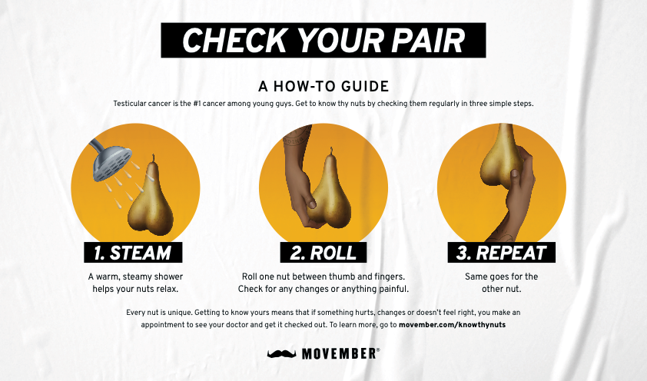
Notes:
**OPTIONAL**
if you don’t wan’t to show the video – you can use this simple slide and run through the steps yourself. (Note: the play on words, “check your pair” and using a pear. Quite clever, right?)
Here are the 3 simple steps:
1) Find a place to do the self-check. Movember recommends the shower as a great spot.
2) Then simply roll your testicle between your thumb and your index finger. It should feel round and smooth. Get to know what feels regular.
3) *Don’t choose favourites* make sure you repeat with the second testicle
Get to know what feels regular. And if one day anything feels different (a lump, pain, the size, etc.) – take action and get it check out.

Slide 7

“We usually get so distracted with how busy our day to day lives are that we neglect to take care of ourselves and to make time for it.
If we can help people become more comfortable talking about their health and being more open, we can catch it early and save lives.”
Ray Clinger
Testicular Cancer Survivor
Notes:
As the video mentioned, if something doesn’t feel right head to the doctors.
Ray Clinger, a testicular cancer survivor, said this: read quote
So, let’s all make sure we are checking, and telling our friends (brothers, partners, colleagues, etc.) to do the same!

Slide 8




HOW WILL YOU TAKE ACTION?
Do a check (How-to guide)
Make it a habit and check in with your nuts. If it doesn’t feel right get it checked by a doctor.
Share what you learned today with a man in your life
Learn more about testicular cancer at movember.com
Notes:
Ok, we’re coming to the end of the slides now.
As we go through the month of April, her are 4 ways that you can take action:

Slide 9

THANK YOU
Learn more at movember.com/knowthynuts
Notes:
Finally, I’ll wrap up by saying, while Movember is renowned for spotlighting men's health in November, I hope this presentation serves as a powerful reminder that our health deserves attention and care every single day of the year.
Thank you everyone for your attention!

